Slide 1
CHINOOK MUSIC STORE ANALYSIS
PUNKIT VERMA

Slide 2
ABOUT CHINOOK
Chinook Music Services is a leading brand in the physical music records market, committed to providing musical entertainment across the globe. With a worldwide network of outlets and services, Chinook offers a diverse and comprehensive genre experience, ensuring that customers enjoy a wide variety of musical styles and content.

Slide 3
PROBLEM STATEMENT
Sales Analysis-
Sales analysis for Chinook Music Services involves evaluating music record sales data to identify trends, customer preferences, and regional performance. This helps in making informed strategic decisions to drive growth in the physical music market. Insights gained can guide promotions, stock management, and customer targeting. The goal is to boost sales and enhance customer satisfaction.
Market Analysis-
Market analysis focuses on understanding customer distribution across different geographical locations. By analyzing regional sales performance and customer behavior, the goal is to identify opportunities for growth. Based on these insights, strategies can be recommended to increase revenue, such as targeted marketing, regional promotions, and expanding services to underperforming areas.

Slide 4

DATA OVERVIEW
The dataset consists of 11 tables, containing various data related to Chinook Music Services.
The company has a customer base spread across 24 different countries worldwide. The tracks sold encompass 25 diverse genres, including Rock, Metal, Jazz, and more.
Additionally, the dataset includes information about the albums and artists associated with each track.
The invoice table records all transactions within the company, providing detailed data on sales activities.

Slide 5
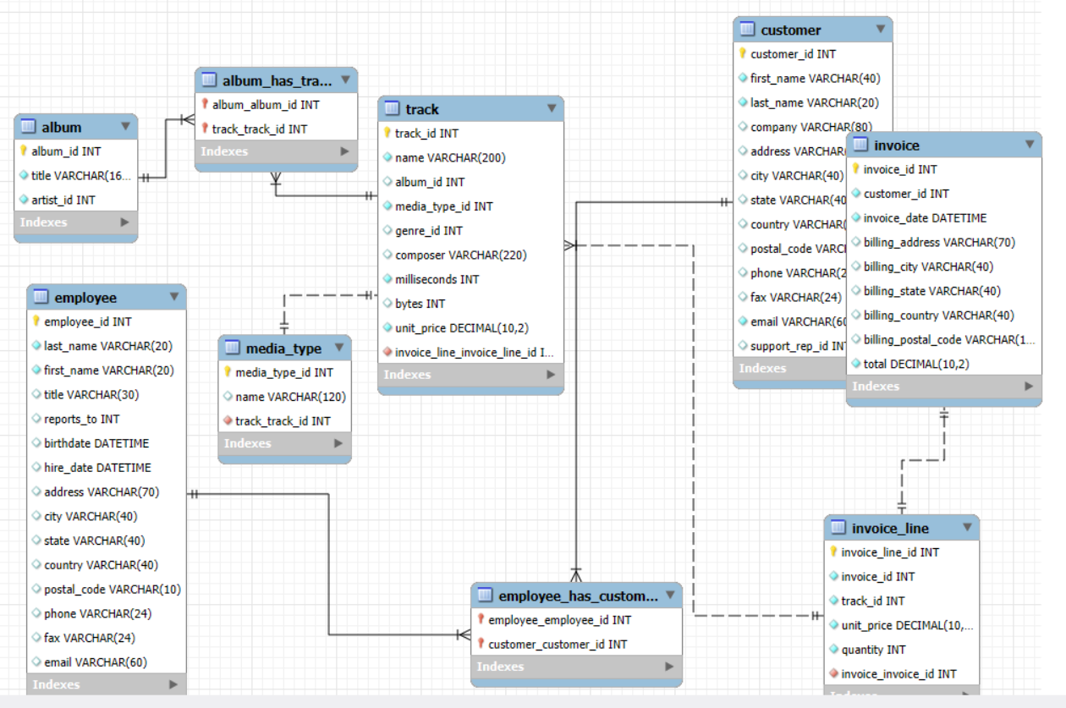
DATABASE SCHEMA

Slide 6
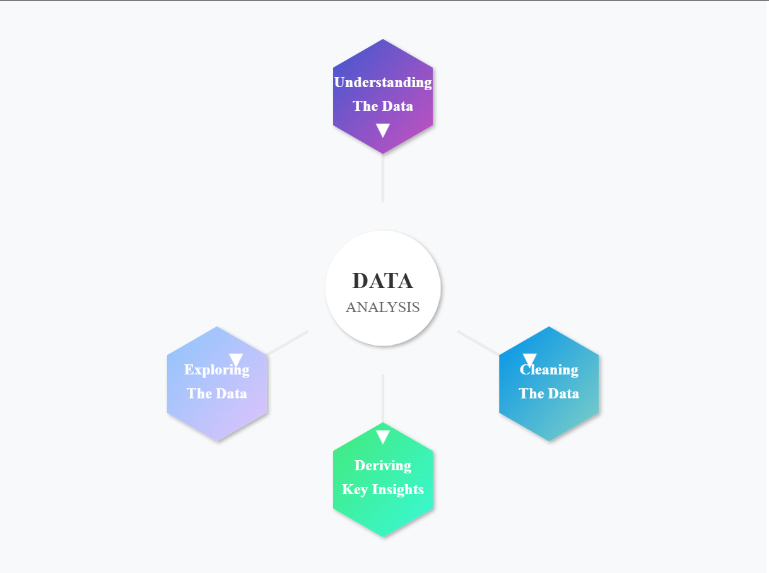
METHODOLOGY

Slide 7
CUSTOMERS IN EACH COUNTRY
Key Takeaways: -
It shows that the customers are from 24 different countries.
The customer demographic breakdown is very diversified.
Maximum number of customers are from USA.

Slide 8
CUSTOMER PURCHASING BEHAVIOR
Key Takeaways: -
Long-term customers are better in all aspects(frequency, basket size, and total spending).
It shows that customer loyalty plays an important role in increasing a company's revenue because long-term customers tend to buy more than short-term customers.
Therefore, the company should focus on the retention rate of the customers to increase sales over time.

Slide 9
TOTAL SALES CONTRIBUTED BY EACH GENRE IN THE USA
Key Takeaways:
The ROCK genre contributes the most to sales in the USA.
The 2nd and 3rd best-selling genres are Alternative & Punk and Metal, respectively.

Slide 10
CUSTOMER CHURN RATE
Key Takeaways:
Customer retention is low, with a high number of customers lost.
Immediate action is needed to maintain the customer base.
New promotional campaigns, music festivals, and sale months should be launched to attract more customers.
Improved customer service can help reduce the churn rate effectively.
40.82%

Slide 11
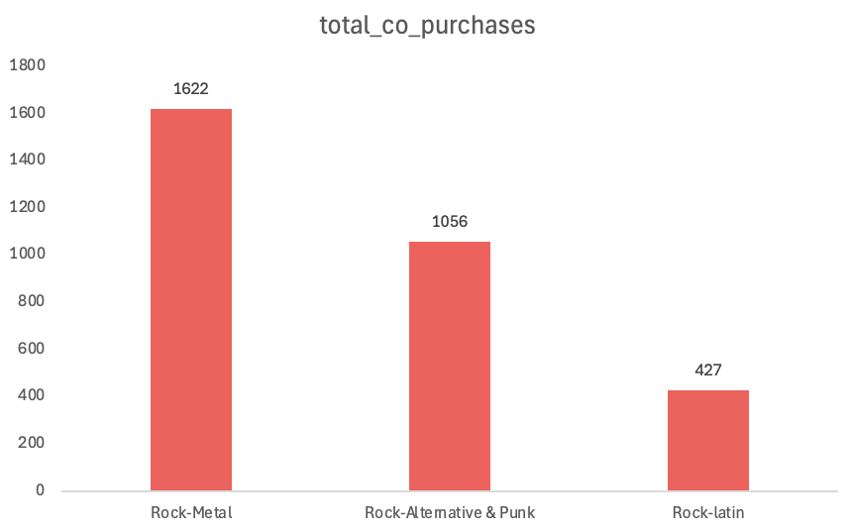
Product Affinity Analysis (Genres frequently purchased together)
Rock frequently combines with genres like Metal, Alternative & Punk, and Latin.
Rock's versatility appeals to customers with diverse music preferences.
Metal customers often purchase Rock, presenting opportunities for cross-promotion.
A strong affinity exists between Alternative & Punk and Rock, highlighting crossover interest.
Co-purchasing trends between Latin music and Rock reveal significant opportunities.
Recommending Latin music to Rock fans can leverage varied customer tastes.

Slide 12

Recommended Albums for Promotion in the USA
Are You Experienced?
Genre: Rock
Reason for Promotion: Rock is a top-performing genre in the USA, and this album stands out in the market. Targeting this strong segment is likely to yield high returns.
Get Born
Genre: Alternative & Punk
Reason for Promotion: With growing popularity, this genre appeals to contemporary music fans. The album’s strong sales momentum makes it an ideal candidate for promotion.
The Doors
Genre: Rock
Reason for Promotion: As a classic rock favorite with historical significance, this album appeals to both nostalgic fans and new listeners, reinforcing the label’s market position.

Slide 13

Overall Strategy Recommendations for the Physical Music Market
Prioritize High-Performing Genres
Rock and Alternative & Punk: Focus promotions on these top-selling genres, particularly in the USA, to capitalize on their established demand.
Region-Specific Strategies
USA: Highlight Rock and Alternative album promotions.
International Markets: Boost sales by promoting Metal and Rock in regions with strong co-purchase patterns.
Cross-Selling Opportunities
Co-Purchased Genres: Bundle Rock and Alternative & Punk albums with Metal to leverage frequent co-purchase trends.
Artist Synergy: Promote bundles featuring artists like Led Zeppelin, Green Day, and Foo Fighters to maximize sales.
Focus on Long-Term Customers
Loyalty Programs: Reward loyal customers with exclusive releases or benefits to maintain engagement.
Churn Prevention: Re-engage inactive customers through targeted emails and limited-time offers.

Slide 14
Final Conclusion
Focused Genre Promotion
Emphasize high-performing genres like Rock and Alternative & Punk, especially in the USA, to maximize sales through targeted album promotions.
Cross-Selling Opportunities
Boost revenue by leveraging product affinity and cross-selling frequently co-purchased genres, artists, and albums.
Region-Specific Targeting
Tailor strategies by focusing on Rock and Alternative in the USA, while promoting Metal and Rock in international markets.
Customer Retention
Enhance lifetime value by preventing churn among long-term customers through targeted campaigns and personalized offers.
Final Takeaway By promoting top genres, capitalizing on cross-selling, and prioritizing customer retention, the company can strengthen its market position and drive sustained growth.

Slide 15
THANK
YOU

